Slide 1

Centre for Project Management
Welcomes you to
Post Graduate in Advanced Project Management
Batch 33 – PG-APM

Slide 2
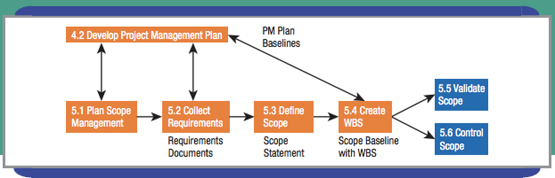
Scope Planning

Slide 3
Core Objectives
Describe the planning of scope management, collecting requirements, & defining scope processes
Create a requirements traceability matrix, project scope statement, & change request form
Describe a work breakdown structure (W B S) and why it is important
Compare different methods of developing a W B S
Technical Objective
Create a WBS, including work packages and a numbering system for the code of accounts, both by hand and using MS Project

Slide 4
Web Intelligence Solutions from Teradata
“An effective scope management approach fosters open communications and sound decision making to ensure all parties get the business value expected from the project”
Mike Van Horn, Teradata

Slide 5
Scope Planning Processes
Plan Scope Management
Collect project requirements
Define project scope
Create work breakdown structure (W B S)
Establish change control

Slide 6
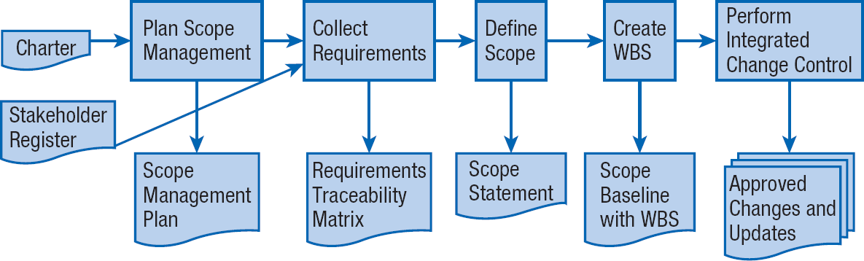
Flow of Scope Planning
SCOPE PLANNING FLOW

Slide 7
Plan Scope Management
Plan scope management – the process of developing a plan that includes the total scope of what needs to be done and what is excluded from the project; implementation and validation of the scope; and how to control deviations from the scope statement.
Total scope = product scope + project scope
Product scope – outputs the team will deliver to its customers
Project scope – the work needed to be performed in order to deliver the project’s outputs

Slide 8

Collect Requirements
Make sure the project team is absolutely clear on the project objectives!
Requirement– a condition or capability needed by a user to solve a problem or achieve an objective that satisfies a standard, specification, or any other formally-documented need.
Collect requirements – a systematic effort to understand and analyze stakeholder needs to define and document these needs and requirements with a focus on meeting project objectives.

Slide 9

Gather Stakeholder Input & Needs (1 of 3)
Use voice of the customer techniques (V O C)
  Ask questions
  Place yourself in the customer’s situation
State customer desires in operational terms
Collecting requirements is same regardless of type of project. Generally Agile documentation is less formal, thus allowing for progressive elaboration

Slide 10
Gather Stakeholder Input & Needs (2 of 3)
Common methods for obtaining & documenting requirements:
  Meetings with Stakeholders
  Interviews
  Focus Groups
  Questionnaires
  Surveys
  Observations
  Prototypes
  Industry Standards
  Reference Documents
  Market Analysis
  Competitive Analysis
  Client Requests
  Standard Specifications

Slide 11
Gather Stakeholder Input & Needs (3 of 3)
Seek a high-level description:
What do we not understand about the feature?
What is the business reason for the feature?
What is the impact of not providing this feature?
What action items need to be accomplished if we do this?
What impact will this have on other features of the project or elsewhere?

Slide 12
Requirements Traceability Matrix
REQUIREMENTS TRANSLATED INTO SPECIFICATIONS
REQUIREMENTS | SPECIFICATIONS
Unambiguous—not subject to interpretation Complete—nothing left out Consistent—no conflicts, which also means no duplication Modifiable—amenable to change Traceable—to a customer need Verifiable—means provided to verify the requirement | Unique set—each stated only once Normalized—should not overlap Linked set—shows relationships Complete—nothing left out Consistent—no conflicts Bounded—specifies nonnegotiable constraints Modifiable—amenable to change Configurable—traceable changes Granular—right level of abstraction
Adopted from: IEEE 1233

Slide 13
Define Scope
Define scope – the process of translation stakeholder needs and requirements into detailed specifications of the project outcomes & products
Reasons to Define Scope
How to Define Scope
  List deliverables and acceptance criteria
  Establish project boundaries
  Create a project work statement
Defining Scope in Agile Projects

Slide 14
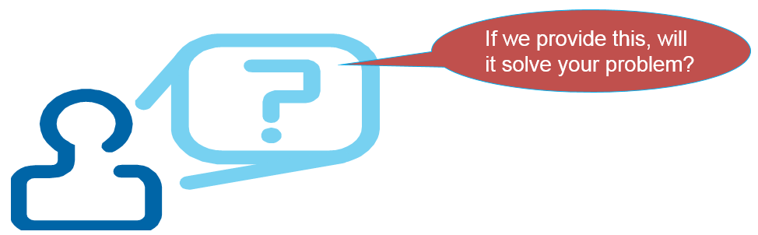
Reasons to Define Scope
All other planning is based on the project scope
Needed to preventing scope creep

Slide 15

How to Define Scope
List project deliverables
  Determine acceptance criteria
Establish project boundaries
  In scope versus Out of scope
  Understand constraints
Create a Scope Definition

Slide 16
Scope Statement (1 of 2)
ALTERNATIVE BREAKS PROJECT SCOPE STATEMENT
Scope Description: This project will educate groups of 12 students on social justice issues, send them out to perform direct service on the issues, and provide reflective opportunities throughout the process. Key deliverables with acceptance criteria (product scope):
KEY DELIVERABLES | ACCEPTANCE CRITERIA
Project plan | Secured housing, Agreement with organization
Fundraising | Adequate money
Education | Syllabus
Reorientation | Digital archives
Trip itself | Return safely, pre- and post-evaluation

Slide 17
Scope Statement (2 of 2)
Exclusions: No alcohol, drugs, or romances; ratio number of trips to student population
Constraints: Van holds only 12 people—11 students and one faculty or staff; number of highly qualified site leaders
Assumptions: Service builds active citizens; international trips add more value than expense; a trip is better with a staff or faculty member.
Source: Chris Bridges.

Slide 18

Defining Scope in Agile Projects (1 of 2)
At beginning of project, overall scope only identified at high level
Backlog of possible work identified also
Use smaller, frequent iterations to get feedback, as customer desires evolve over time
Customer representative (“owner”) prioritizes scope based on business need, value, cost, & risk.

Slide 19
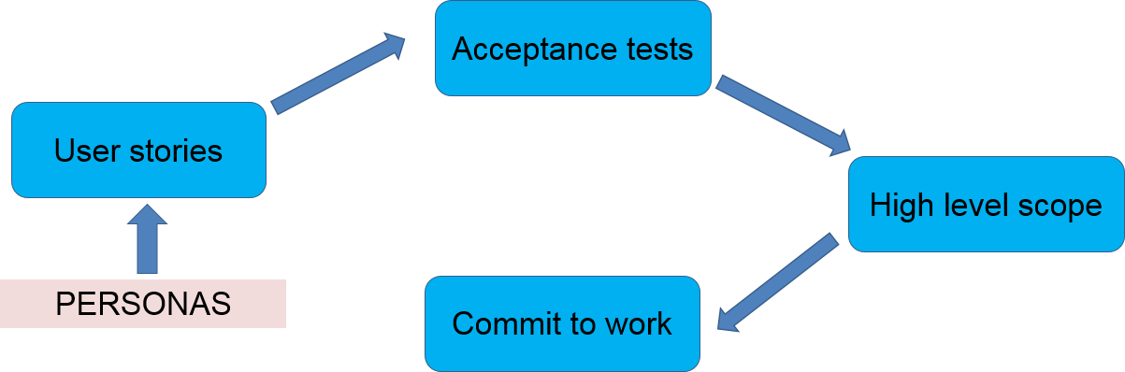
Defining Scope in Agile Projects (2 of 2)

Slide 20
Work Breakdown Structure (W B S)
What is the W B S?
Why use a W B S?
W B S Formats
Work Packages
How to Construct a W B S

Slide 21

What is the W B S?
Tool to progressively divide project deliverables into smaller pieces
Identifies all deliverables
A framework for further planning, execution, and control
Define activity – a project planning process which identifies and determines specific actions to develop and deliver the project outcomes, such as products, services or results

Slide 22
Why use a W B S?
Ensures all parts of project are considered
Adds discipline and visibility to project planning
Basis for planning schedule, resources, cost, quality, & risk
Useful in determining where and why problems occur
Helpful in project communications

Slide 23
W B S Formats
Indented outline
Organizational chart
Free format

Slide 24
W B S - Indented Outline Format
HOUSE W B S IN INDENTED OUTLINE FORMAT
HOUSE
Project Management
Framed House
  Framing Contractor
  Wood
  Assembled Frame
Wired House
  Wiring Contractor
  Wiring
  Installed Wiring
Drywalled House
  Drywall Contractor
  Drywall
  Hung Drywall
Useful when typing W B S into scheduling software

Slide 25
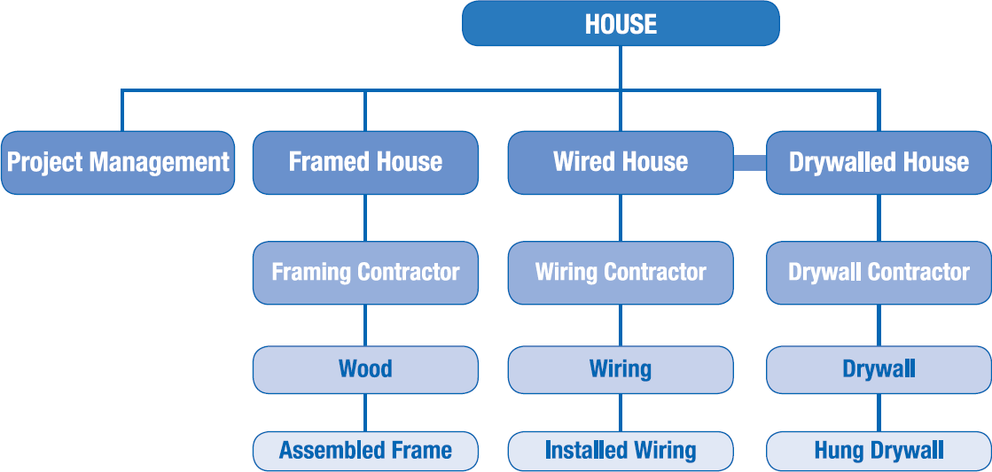
W B S in Org Chart Format
Familiar
Easy to understand
Flexible

Slide 26
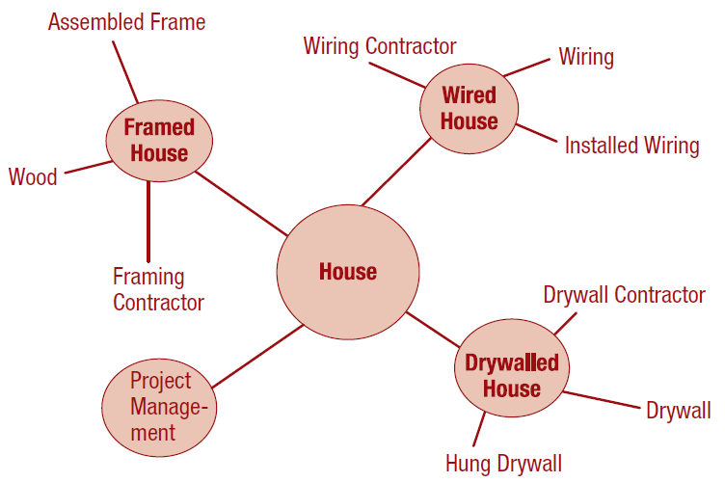
W B S in Free Format
Completely flexible
Especially useful when project’s structure is not initially clear

Slide 27
Work Packages (1 of 3)
Lowest level of W B S
Basis for subsequent planning & control
Work activities are defined
Schedule is formed
Resources are aligned
Control features are developed

Slide 28
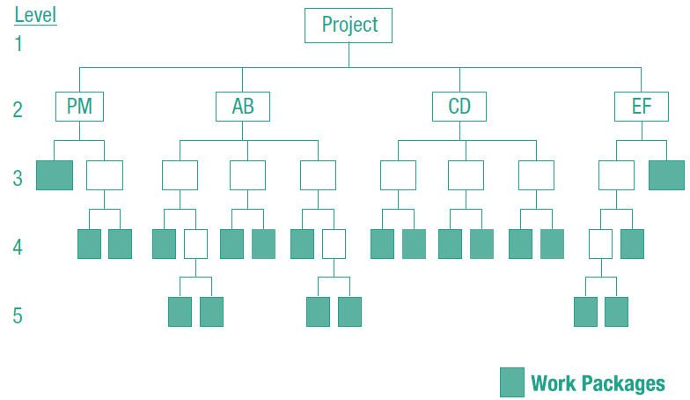
Work Packages (2 of 3)
W B S DEPICTING WORK PACKAGES
Source: Kevin P. Grant, U T S A.
Work package – deliverable at the lowest level of the W B S, for which cost and duration can be estimated & managed

Slide 29
Work Packages (3 of 3)
State succinctly in very few words (use adjectives, not verbs!)
W B S component – “an entry in the W B S that can be at any level.” P M B O K® Guide
W B S dictionary – document that provides detailed information about every work package, including deliverable details; activity; scheduling information; predecessor & successor activities; person responsible; resources required; & risks.

Slide 30
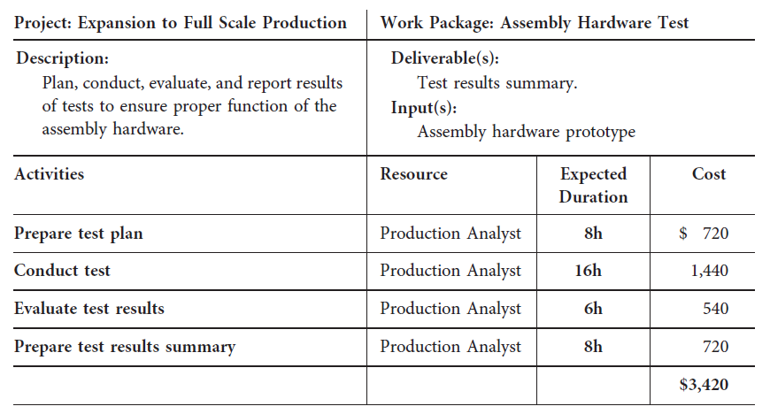
Work Package Detail
Source: Kevin P. Grant, U T S A.

Slide 31
How to construct a W B S
Include appropriate subject matter experts (S M Es)
Use a top-down approach
Consider W B S from a previous project as a starting point
Use brainstorming

Slide 32
Steps in W B S Construction
Identify major deliverables
Decompose deliverables
Continue until deliverables are the right size
Review

Slide 33
Identify Major Deliverables
Begin with Scope Statement
Organize in systematic manner such as by project phase
Facilitates rolling wave planning—planning near term work in detail and future work at a higher level
Rolling wave planning → quick start
Helps avoid:
  Analysis paralysis - never starting anything because the plan is not complete
  Ready, fire, aim – not planning at all

Slide 34
W B S Organization Examples
PROJECT PHASE | DESIGN COMPONENTS/DELIVERABLES | WORK FUNCTION/ SUBPROJECT
Project Management | Project Management | Project Management
Contract | Kitchen | Carpentry
Foundation | Bedrooms | Plumbing
Framed House | Bathrooms | Electrical
… | … | …

Slide 35
Decompose Deliverables
Brainstorm list of interim and final deliverables (use Post It® Notes)
Assemble deliverables on large work space
Organize deliverables into related groups
Decomposition – breaking down into smaller and smaller pieces

Slide 36
Continue Until Deliverables Are the Right Size
PARTIAL W B S OF CAR DEVELOPMENT PROJECT
Car Development Project
Project Management
Product Design
Product Goals
Concept Design
Modeling Design
Vehicle Integration
Engineering Feasibility
Detailed Engineering Design
Performance Development
Regulatory Certification
Process Development
Prototype
Production Materials Procurement
General Materials Procurement
Trial Manufacture
When to stop decomposing? Judgment call…Ideally, work packages are:
Small enough to control
Not so small as to micro-manage

Slide 37
Review
Ensure completeness
  Consider parent-child concept
  Have between 3 and 9 child elements for each parent
Assign a unique name & number to each component

Slide 38
Establish Change Control (1 of 2)
Projects are conducted in an atmosphere of uncertainty
Plans must be made to ensure all potential changes are considered, accepted or rejected, and that their impact is factored into revised plans
Change control system – a system of managing and controlling changes and modifications to the project plan and project deliverables
Baseline – the approved project plan, mostly consisting of scope, schedule, & cost; should not be altered without going through integrated change control system

Slide 39
Establish Change Control (2 of 2)
Document potential changes to a project with a change request
Every change to a project must be formally proposed
Change request – a written request or formal proposal to change any project planning component, such as a document, project deliverable, or the baseline (scope, cost, and time).

Slide 40
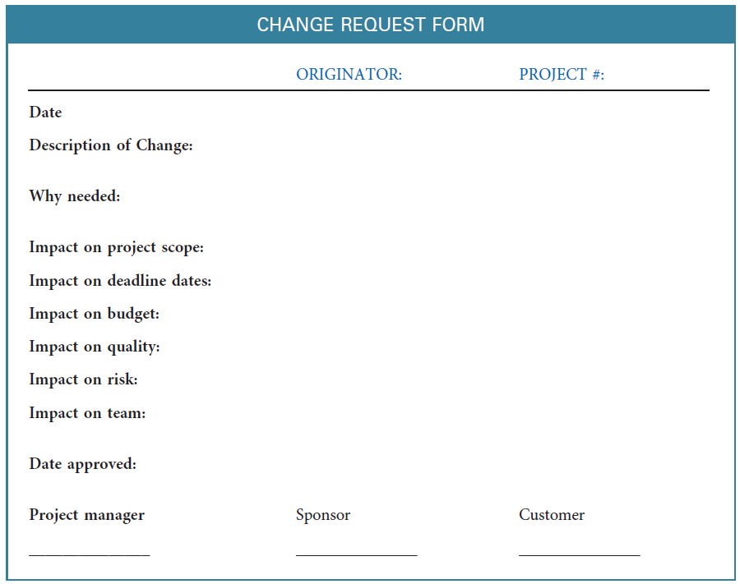
Change Request Form

Slide 41
Using MS Project for Work Breakdown Structures (W B S)
Set Up the W B S
​Understand W B S definitions & displays.
​Enter project deliverables & work package elements.
​Create the outline of your W B S.
​Insert a W B S code identification column.
​Hide (or show) the desired amount of detail in W B S.

Slide 42
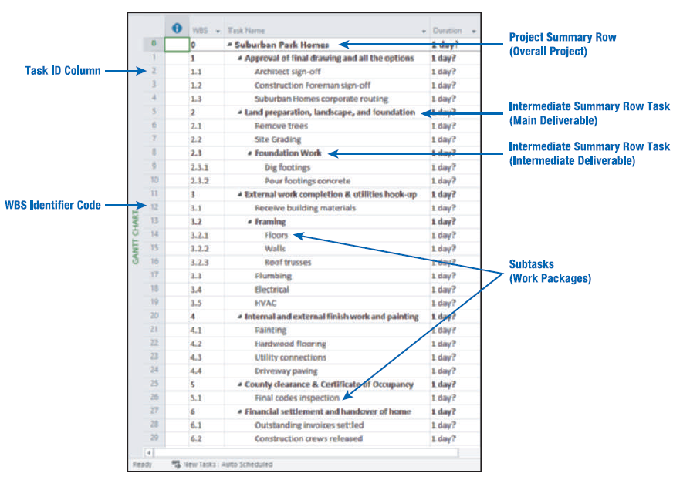
Step 1. Understand W B S displays and definitions
Summary tasks are displayed:
  Tables as an outline
  Gantt view
7.15: GANTT CHART VIEW THREE-LEVEL W B S
Source: Microsoft product screenshots reprinted with permission from Microsoft Corporation.

Slide 43
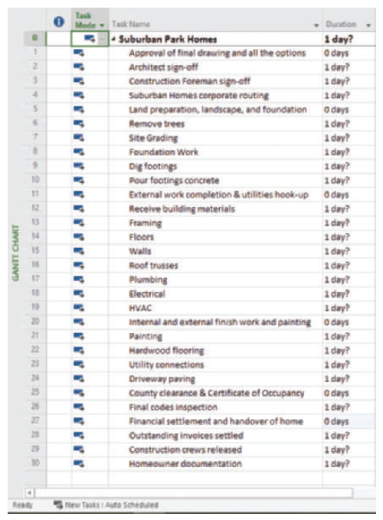
Step 2. Enter W B S Elements (Tasks) (1 of 2)
ENTER SUMMARIES (DELIVERABLES)
Source: Microsoft product screenshots reprinted with permission from Microsoft Corporation.

Slide 44
Summary
Use scope planning to determine deliverables and acceptance criteria.
Organize scope into a work breakdown structure (W B S).
Decompose the project into smaller and smaller pieces.
Assign W B S components.
Create W B S by hand or use MS Project to create W B S.

